Slide 1

Course Name - Object Oriented Programming using Java
Lecture 36 – Parameter Passing in Applets
Presented By
Dr. Sudipta Sahana
Asso. Prof.
Dept. of CSE
UEM – Kolkata

Slide 2
Topic of Interest
Parameter Passing to an Applet
Param Tag
getParameter() Method
Example of Parameter passing To An Applet

Slide 3
Parameter Passing to an Applet
Here I will show you how to pass some parameters to an applet and how to read those parameters in an applet to display their values in the output.
Steps to accomplish this task :
To pass the parameters to the Applet we need to use the param attribute of <applet> tag.
To retrieve a parameter's value, we need to use the getParameter() method of Applet class.

Slide 4
Param Tag
The <param> tag is a sub tag of the <applet> tag. The <param> tag contains two attributes: name and value which are used to specify the name of the parameter and the value of the parameter respectively.
For example, the param tags for passing name and age parameters looks as shown below:
<param name=“name” value=“ABC” />
<param name=“age” value=“7”/>
Now, these two parameters can be accessed in the applet program using the getParameter() method of the Applet class.

Slide 5
getParameter() Method
The getParameter() method of the Applet class can be used to retrieve the parameters passed from the HTML page.
Method takes a String argument name, which represents the name of the parameter which was specified with the param attribute in the <applet> tag.
Method returns the value of the name parameter(if it was defined) else null is returned.
The syntax of getParameter() method is as follows:
String getParameter(String param-name)

Slide 6
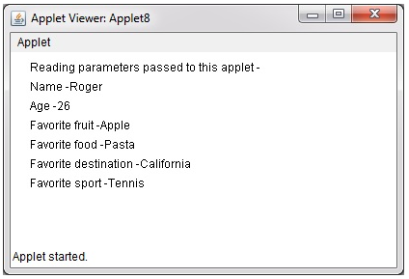
Example of Parameter passing To An Applet
MyApplet.java
import java.awt.*;
import java.applet.*;
public class MyApplet extends Applet {
String name;
String age;
String sport;
String food;
String fruit;
String destination;
public void init(){
name = getParameter("Name");
age = getParameter("Age");
food = getParameter("Food");
fruit = getParameter("Fruit");
destination = getParameter("Destination");
sport = getParameter("Sport"); }
public void paint(Graphics g){
g.drawString("Reading parameters passed to this applet -", 20, 20);
g.drawString("Name -" + name, 20, 40);
g.drawString("Age -" + age, 20, 60);
g.drawString("Favorite fruit -" + fruit, 20, 80);
g.drawString("Favorite food -" + food, 20, 100);
g.drawString("Favorite destination -" + name, 20, 120);
g.drawString("Favorite sport -" + sport, 20, 140);
}}
abc.html
<applet code=“MyApplet" width="400" height="200">
<param name="Name" value="Roger">
<param name="Age" value="26">
<param name="Sport" value="Tennis">
<param name="Food" value="Pasta">
<param name="Fruit" value="Apple">
<param name="Destination" value="California">
</applet>

Slide 7
Thank You

